Slide 1


Professional Law, Ethics, Values & Humanity
MLC- SYBTech
Faculty- Dr. Kshipra Moghe

Slide 2



1. Self Awareness
Understanding ourself

Slide 3
Johari Window
Joseph Luft & Harry Ingham (1955)
Used for self awareness, self-development, group development & understanding relations
Gives information about attitudes, emotions, feelings, skills, motivation, perceptions, etc

Slide 4
JOHARI Window |  | SELF
 |  | Known | Unknown
OTHERS | Known | OPEN | BLIND
 | Unknown | PRIVATE | DARK

Slide 5
What is effectiveness?
Self-Disclosure
Sharing about self
More expression more cooperation- healthy development
Openness to Feedback
Accepting every feedback openly
Being careful about giving feedback
Perceptiveness
Being open to experiences
Willingness to bring changes in self

Slide 6
Assignment 1
What are your common, surprising and unique characteristics? How does your Johari window appear to you? (5 marks)
What changes would you like to make in your Johari Window and How? Would you convert some characteristics to common/open area? (5 marks)

Slide 7

2. Planning
Plans vs. Goals
Dreams & Wishes

Slide 8
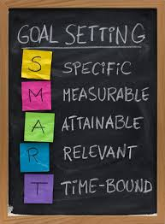
Planning & Goal Setting
Set task-related goals rationally
Decide on the effort and time required for achieving goals
SMART goals
Feedback on performance
Rational goal setting according to potentials increases motivation
Importance of commitment

Slide 9
My planning chart
 | Academic | Co-Curricular | Extra-Curricular
Short Term Planning
Long Term Planning
Extempore Planning

Slide 10
Assignment 2
Create the planning chart (5 marks)
Will there be any hurdles/weaknesses in achieving your goals? How would you work on those/handle it? (5 marks)

Slide 11

3. Motivation

Slide 12
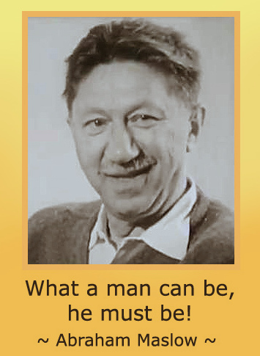
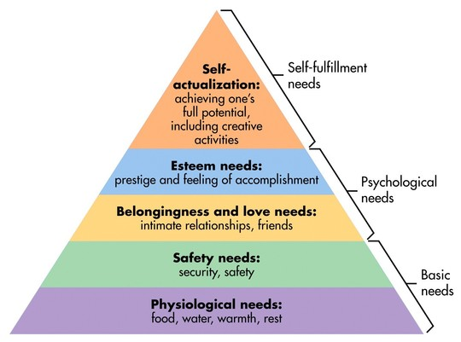
Transcendence Needs
Aesthetic Needs
Cognitive Needs

Slide 13
Interpretation
1 Biological Needs G
2 Safety Needs E
3 Belongingness and Love Needs B
4 Esteem Needs A
--------------------------------------------
5 Cognitive Needs H
6 Aesthetic Needs C
7 Self-Actualization Needs D
8 Transcendence Needs F
Maslow said that needs 1-4 are deficiency motivators and are generally satisfied in order when the previous need is fully or partially satisfied.
If ticked above they are probably satisfied. If a need ceases to be satisfied there is less or no motivation to strive to maintain or satisfy higher level needs.
Needs 5-8 are growth motivators. If ticked above they are likely to be a focus of personal growth motivation.
This test is based on Maslow’s Hierarchy of Needs.

Slide 14
Assignment 3
What were your first FOUR preferences in the Maslow’s hierarchy? (5 marks)
Can you link these with your goals? (5 marks)

Slide 15

4. Human Values & Ethics

Slide 16
Take a few minutes to think about the meaning of the items listed below. Indicate with a check mark the items that are important to you.
A physical appearance to be proud of
To graduate with honors
Being an honest person
To have political power
Being known as a “real” person
A meaningful relationship
Self-confidence and personal growth
Enjoyment of nature and beauty
A life with meaning, purpose, fulfillment
Continuing to learn and gain knowledge
A chance to help the disadvantaged
To be attractive to others
Some honest and close friends
A long and healthy life
n A meaningful relationship with God
A good marriage
Satisfaction/success in the career of your choice
An equal opportunity for all people
Freedom to live life as you want
A financially comfortable life
Accomplishment of something worthwhile
A secure and positive family life
An enjoyable, leisurely life
Unlimited travel, fine foods, entertainment, recreational, and cultural opportunities
Getting things changed for the better
A beautiful home in the setting of your choice
A chance to develop creativity/potential in any area
Owning a possession of great value
To speak up for my personal beliefs
To have better feelings about myself
To be needed and to be important to others
To become a good parent
To have a better relationship with my parents
To be charming
To persevere in what I am doing
Time for prayer
To give of myself freely in helping others
A safe and secure environment
To be loved by a special few
To be trusted by others

Slide 17
List below the number of the top five items that are most important to you:
1. ____
2. ____
3.____
4.____
5. ____
When you have listed the 4 to 5 items that are most important to you, refer to the “Value Characteristics” sheet and write the appropriate characteristics related to these numbers.

Slide 18
Number | Characteristics
5 | Sincerity
3, 40 | Honesty, Integrity
7, 30 | Emotional well-being, Stability
8 | Artistic appreciation
2, 10 | Education, Intelligence, Wisdom
11, 37, 18 | (Altruism) Compassion, Fairness, Justice
1, 12, 34 | Appearance, Beauty, Approval
6, 13, 31, 39 | Love, Friendship, Personal closeness
14, 38 | Health, Personal safety, Security
15, 36 | Religion, Spirituality
16, 22, 32, 33 | Family, Love, Emotional security
9, 17, 21, 27 | Fulfillment, Intellectual and Vocational achievement
19 | Personal freedom, Independence
20, 26, 28 | Financial security, Money, Status
23, 24 | Pleasure, Travel, Material satisfaction
4, 25 | Power, Achievement
29 | Courage
35 | Perseverance

Slide 19
Morals are the welfare principles enunciated by the wise people, based on their experience and wisdom.
Morality | Ethics
1. More general and prescriptive based on customs and traditions. | 1. Specific and descriptive. It is a critical reflection on morals.
2. More concerned with the results of wrong action, when done. | 2. More concerned with the results of a right action, when not done.
3. Thrust is on judgment and punishment, in the name of God or by laws. | 3. Thrust is on influence, education, training through codes, guidelines, and correction.
4. In case of conflict between the two, morality is given top priority, because the damage is more. It is more common and basic. | 4. Less serious, hence second priority only. Less common. But relevant today, because of complex interactions in the modern society.
5. Example: Character flaw, corruption, extortion, and crime. | 5. Example: Notions or beliefs about manners, tastes, customs, and towards laws.

Slide 20
A value is defined as a principle that promotes well-being or prevents harm.” Another definition is: Values are our guidelines for our success—our paradigm about what is acceptable.”
Personal values are defined as: “Emotional beliefs in principles regarded as particularly favorable or important for the individual.” Our values associate emotions to our experiences and guide our choices, decisions and actions.

Slide 21
Values
Filter observations in the environment and take decision
Used as scales to weigh our choices
Beliefs, values and identity usually acquired unconsciously
Brain behaviour

Slide 22
CORE VALUES
Right conduct:
Self help skills
Social skills
Ethical skills
Peace: Attention, calmness, concentration, contentment, dignity, discipline, equality, equanimity, faithfulness, focus, gratitude, happiness, harmony, humility, inner silence, optimism, patience, reflection, satisfaction, self-acceptance, self-confidence, self-control, self-discipline, self-esteem, self-respect, sense control, tolerance, and understanding
Truth: Accuracy, curiosity, discernment, fairness, fearlessness, honesty, integrity (unity of thought, word, and deed), intuition, justice, optimism, purity, quest for knowledge, reason, self-analysis, sincerity, sprit of enquiry, synthesis, trust, truthfulness, and determination.

Slide 23
Love: Acceptance, affection, care, compassion, consideration, dedication, devotion, empathy, forbearance, forgiveness, friendship, generosity, gentleness, humanness, interdependence, kindness, patience, patriotism, reverence, sacrifice, selflessness, service, sharing, sympathy, thoughtfulness, tolerance and trust
Non-violence:
Psychological- Benevolence, compassion, concern for others, consideration, forbearance, forgiveness, manners, happiness, loyalty, morality, and universal love
Social- Appreciation of other cultures and religions, brotherhood, care of environment, citizenship, equality, harmlessness, national awareness, perseverance, respect for property, and social justice.

Slide 24
Assignment 4
Which values did you choose and why? Write reasons. (5 marks)
As a student, which values do you think will help you achieve your goals? (5 marks)

